Slide 1

Harmonizing AlphaCorp: Unveiling a Unified Multi-Domain Enterprise Architecture

Slide 2
Agenda
AlphaCorp Current State Analysis
Enterprise Architecture Framework
Predictive Modeling
Cybersecurity
Product Development Integration – Healthcare
Solutions

Slide 3
AlphaCorp Current State Analysis

Slide 4



AlphaCorp – Three Divisions Into One
Enhance patient care through innovative technology integration.
Achieve top-tier data security and compliance with healthcare regulations.
Streamline operations for cost efficiency and service quality.
Lead in cybersecurity measures to protect financial transactions.
Drive innovation in financial services to enhance customer experience.
Optimize operational costs through technological advancements.
Enhance user experience with personalized shopping and efficient service.
Expand market reach through diversified product offerings and marketing strategies.
Scale operations effectively to support growth without significant cost increases.
Strategic Goals
Addressing the rising cybersecurity threats to patient data.
Integrating telehealth services with existing healthcare and cross-domain systems.
Adapting to rapid changes in fintech regulations and cybersecurity threats.
Ensuring seamless integration of payment solutions with healthcare and e-commerce platforms.
Balancing rapid expansion with maintaining high customer satisfaction.
Integrating e-commerce platforms with fintech and healthcare services for a unified customer experience.
Challenges
Goal
To create a unified user experience and architecture across AlphaCorp.
Notes:
There are three main divisions of AlphaCorp as we know which are Healthcare, Fintech, and E-Commerce with each division having their own strategic goals and challenges. Starting with Healthcare, their strategic goals are to enhance patient care through innovative technology integration, achieve top-tier data security and compliance with healthcare regulations, and streamline operations for cost efficiency and service quality. The challenges the Healthcare division faces are addressing the rising cybersecurity threats to patient data and integrating telehealth services with existing healthcare and cross-domain systems. Moving on to Fintech they have the goals of being a leader in cybersecurity measures to protect financial transactions, drive innovation in financial services to enhance customer experience, and optimize operational costs through technological advancements. Their challenges are adapting to rapid changes in fintech regulations and cybersecurity threats and ensuring seamless integration of payment solutions with healthcare and e-commerce platforms. Last but not least, E-commerce has the goals of enhancing user experience with personalized shopping and efficient service, expanding market reach through diversified product offerings and marketing strategies, and scaling operations effectively to support growth without significant cost increases. The challenges they face are balancing rapid expansion with maintaining high customer satisfaction and integrating e-commerce platforms with fintech and healthcare services for a unified customer experience.
The overall goal by introducing an Enterprise Architecture framework is to create a unified user experience and architecture across AlphaCorp.

Slide 5
AlphaCorp Analysis – Additional Pain Points
Lack of a standardized communication protocol.
Reduces the efficiency in multi-department collaborations.
Causes delays in project timelines.
Potential for data breaches and other security vulnerabilities.
Currently deploy independent data storage across divisions.
Increases the operational costs.
Creates headaches in data management and backing up of sensitive and important data.
Causes inconsistencies in the data, leading to compliance concerns.
Outdated software systems and infrastructure.
Limited scalability in operations.
Wasteful expenditures in all facets of the business.
Data transfer times are very slow, causing bottlenecks in various processes.
High costs associated with these data transfers.
No clear data recovery plan (DRP).

Slide 6
Market Research
Division | Customer Behaviors | Customer Preferences | Trends and Recommendations
Healthcare | 68% of customers prefer telemedicine over traditional visits. 42% use wearable devices to track health metrics. | 80% demand secure and easy-to-access health records. 55% are interested in AI-assisted diagnosis. | AI-driven personalized treatment plans. Blockchain for secure health records. Invest in secure, blockchain-enabled health record systems.
Fintech | 75% of customers use mobile apps for banking and transactions. | 70% prioritize cybersecurity features. 60% prefer platforms that offer financial advising. | Rise in decentralized finance (DeFi) platforms. Contactless payments via IoT devices. Explore integration of DeFi and cryptocurrency features.
E-Commerce | 90% of purchases are made on mobile devices. 35% of customers utilize in-app chat support. | 50% prefer companies that offer eco-friendly delivery options. 45% look for customization options in the products. | Augmented Reality (AR) enabled virtual trial rooms. Use of big data analytics for personalized marketing. Develop AR capabilities for a more interactive customer experience.

Slide 7
Initial Cybersecurity Findings
Security Features | Security Concerns | External Threats | Internal Metrics
Two-Factor Authentication (2FA): Implemented on all internal and external platforms. End-to-end Encryption: In place for data transmission between various departments and with external partners. | Penetration Testing: Conducted irregularly and not comprehensive in scope. Firewall Integrity: Outdated firewall technology, especially in branch offices. | Ransomware Incidents: Increase of 40% in industry attacks in the last year. Corporate Espionage: Documented attempts to penetrate the corporate network for data theft. | Last Security Incident: 14 months ago. A ransomware attack contained minimal data loss. Employee Security Training: Last updated 18 months ago, no ongoing refresher courses.

Slide 8
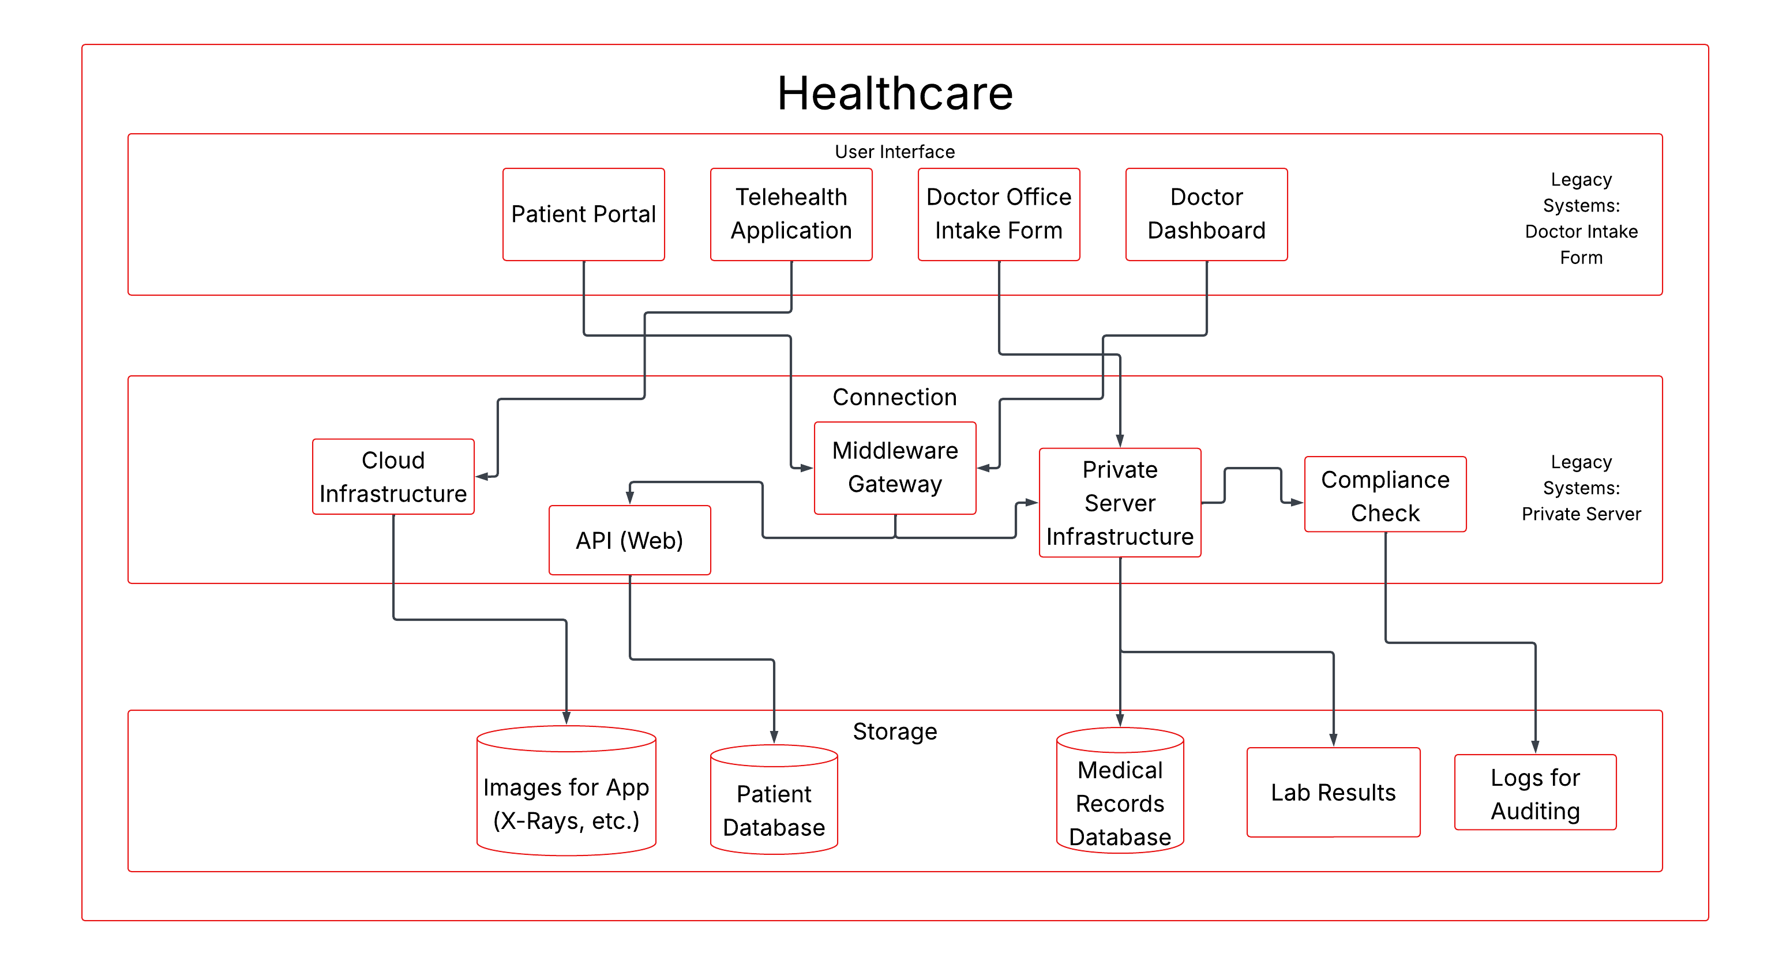
Healthcare – A Closer Look
Notes:
First let's take a closer look at the current state of Healthcare. Each division is broken down into three distinct layers being user interface, connection, and storage. In the user interface layer, we have the patient portal, AlphaCorp’s telehealth application, the doctor intake forms, and the dashboard for the doctor for each patient. In the connection layer, we have the cloud infrastructure on Azure or AWS, our web API, the middleware connection gateway, AlphaCorp’s private server infrastructure, and the current compliance checks that are being performed for this type of data. In the storage layer, we have separate databases for medical records, images, and other patient data. We also have lab results stored in a different process as well as the logs for auditing of the data. As you can see, things are disjointed, and there are legacy systems which lead to inefficiencies in the business.

Slide 9
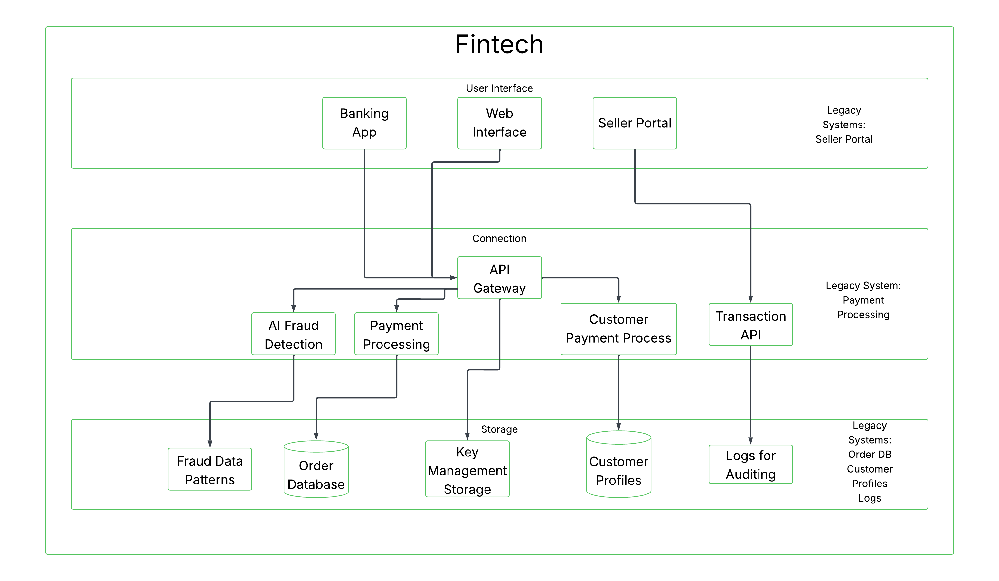
Fintech – A Closer Look
Notes:
Next let’s look at Fintech. Again, we have our user interface, connection, and storage layers. Starting with the user interface we have the banking application, web interface, and a portal for sellers within the AlphaCorp ecosystem to access their information (inventories, etc.). Moving on to the connections, there are APIs connecting the Uis to the AI fraud detection, payment processing, and customer payment process procedures. There is also a separate API for transactions for sellers. Finally in the storage layer there are separate databases for orders and customer profiles. There are also processes for audit logs, key management storage for security keys on the cloud network, and the analysis of the data for fraud detection. Fintech also has disjointed infrastructure with several legacy systems.

Slide 10
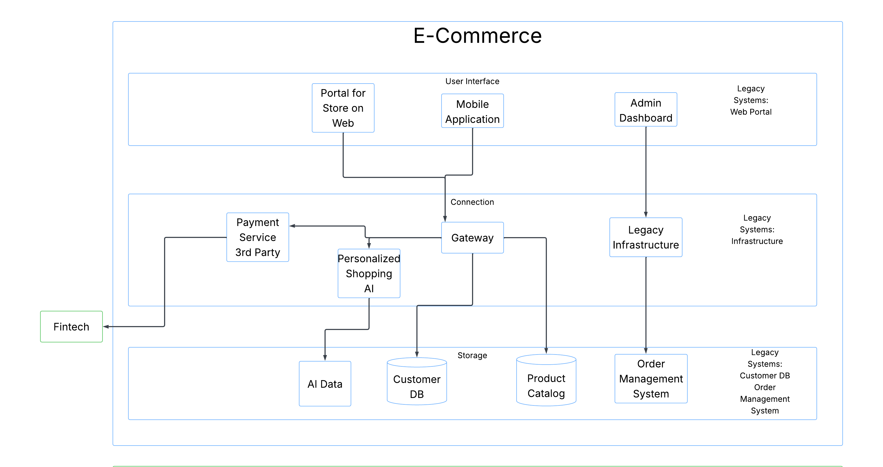
E-Commerce – A Closer Look
Notes:
Lastly let’s look at the E-commerce side of the business. There is a portal for the AlphaCorp store on the web along with a mobile application and an internal admin dashboard for the user interface layer. There is again a separate gateway, some additional legacy infrastructure, a 3rd party payment service which connects the E-commerce store to AlphaCorp’s Fintech division, and a personalized shopping AI procedure that the data goes through. Again, AlphaCorp is separately storing data for its products, customers, AI algorithms, and order management. There are also several legacy systems here that need updating.

Slide 11
Current State
Future State
Integration between the three main divisions is very limited.
Each division operates with legacy and cloud services, creating additional work to move data between the systems.
Security is not consistent across divisions, creating potential gaps and compliance issues.
Legacy storage solutions do not provide the scalability needed for growth.
Creating a unified and modern API strategy for all divisions.
Creating a governance framework for all divisions to operate under.
Update legacy systems to modern technology under a phased approach to mitigate associated risks.
Consolidation of database systems to ensure better allocation of resources.
Increases security profile by managing access to one system instead of many.
Creating scalable systems to ensure proper growth.
Creating a security framework for all divisions to operate under.
Notes:
Analyzing each business unit individually leads us to the following conclusions about the current state of AlphaCorp. Integration between the three main divisions is very limited. Each division operates with legacy and cloud services, creating additional work to move data between the systems. Security is not consistent across divisions, creating potential gaps and compliance issues. Legacy storage solutions do not provide the scalability needed for growth. To solve these issues we need to do the following for the future state of the company. Create a unified and modern API strategy for all divisions. Create a governance framework for all divisions to operate under. Update legacy systems to modern technology under a phased approach to mitigate associated risks. Consolidate database systems to ensure better allocation of resources. This also increases the security profile by managing access to one system instead of many. Create scalable systems to ensure proper growth. Create a security framework for all divisions to operate under.

Slide 12
Budgets
 | Current Fiscal Year | Next Fiscal Year | Additional Info
EA Framework and Repository | $750,000 | $100,000 / yr | Current IT systems have a budget of $300,000 for EA implementation which can be broken down into software licensing, hardware procurement, and training. The ongoing operational costs are $100,000 which are broken down into maintenance, additional training, security measures, and a contingency fund of $50,000.
Predictive Modeling | $200,000 | TBD | The budget for initial implementation has been set aside for the costs associated with data migration and integration. Maintenance and management of cloud architecture and data storage are grouped into the operational costs category. Lastly, a portion of the budget is left alone for unforeseen costs and issues that may occur during the implementation.
Healthcare Product Development | $300,000 | TBD | The budget is firm cap and needs to be followed. Allocated resources must stay within this constraint. Additional funding cannot be moved from other projects or departments either.
Notes:
There is a $750,000 cap for our initial implementation of the framework and repository and $100,000 available for yearly operating costs. Current IT systems have a budget of $300,000 for EA implementation which can be broken down into software licensing, hardware procurement, and training. The ongoing operational costs are $100,000 which are broken down into maintenance, additional training, security measures, and a contingency fund of $50,000.
There is a $200,000 hard cap that has been allocated for this fiscal year. The budget can be broken down into the three main categories of initial implementation, operational costs, and contingency funds. The budget for initial implementation has been set aside for the costs associated with data migration and integration. Maintenance and management of cloud architecture and data storage are grouped into the operational costs category. Lastly, a portion of the budget is left alone for unforeseen costs and issues that may occur during the implementation.
For Healthcare product development a budget of $300,000 is in place for the next fiscal year. The budget is firm cap and needs to be followed. Allocated resources must stay within this constraint. Additional funding cannot be moved from other projects or departments either.

Slide 13
Budget – Current Cloud Contracts
Provider | Term | Services | Limitations
AWS | 1/1/23-12/31/25 | AWS EC2 (Elastic Compute Cloud) AWS S3 (Simple Storage Service) AWS RDS (Relational Database Service) | Data Transfer Out limit: 500 TB per month No Support for AWS Snowmobile Additional costs for premium support.
Azure | 6/1/23-5/31/26 | Azure Virtual Machines Azure Blob Storage Azure SQL Database | No Service-Level Agreement (SLA) for Free Services Resource limitations based on region 100 TB per month of egress data transfer

Slide 14
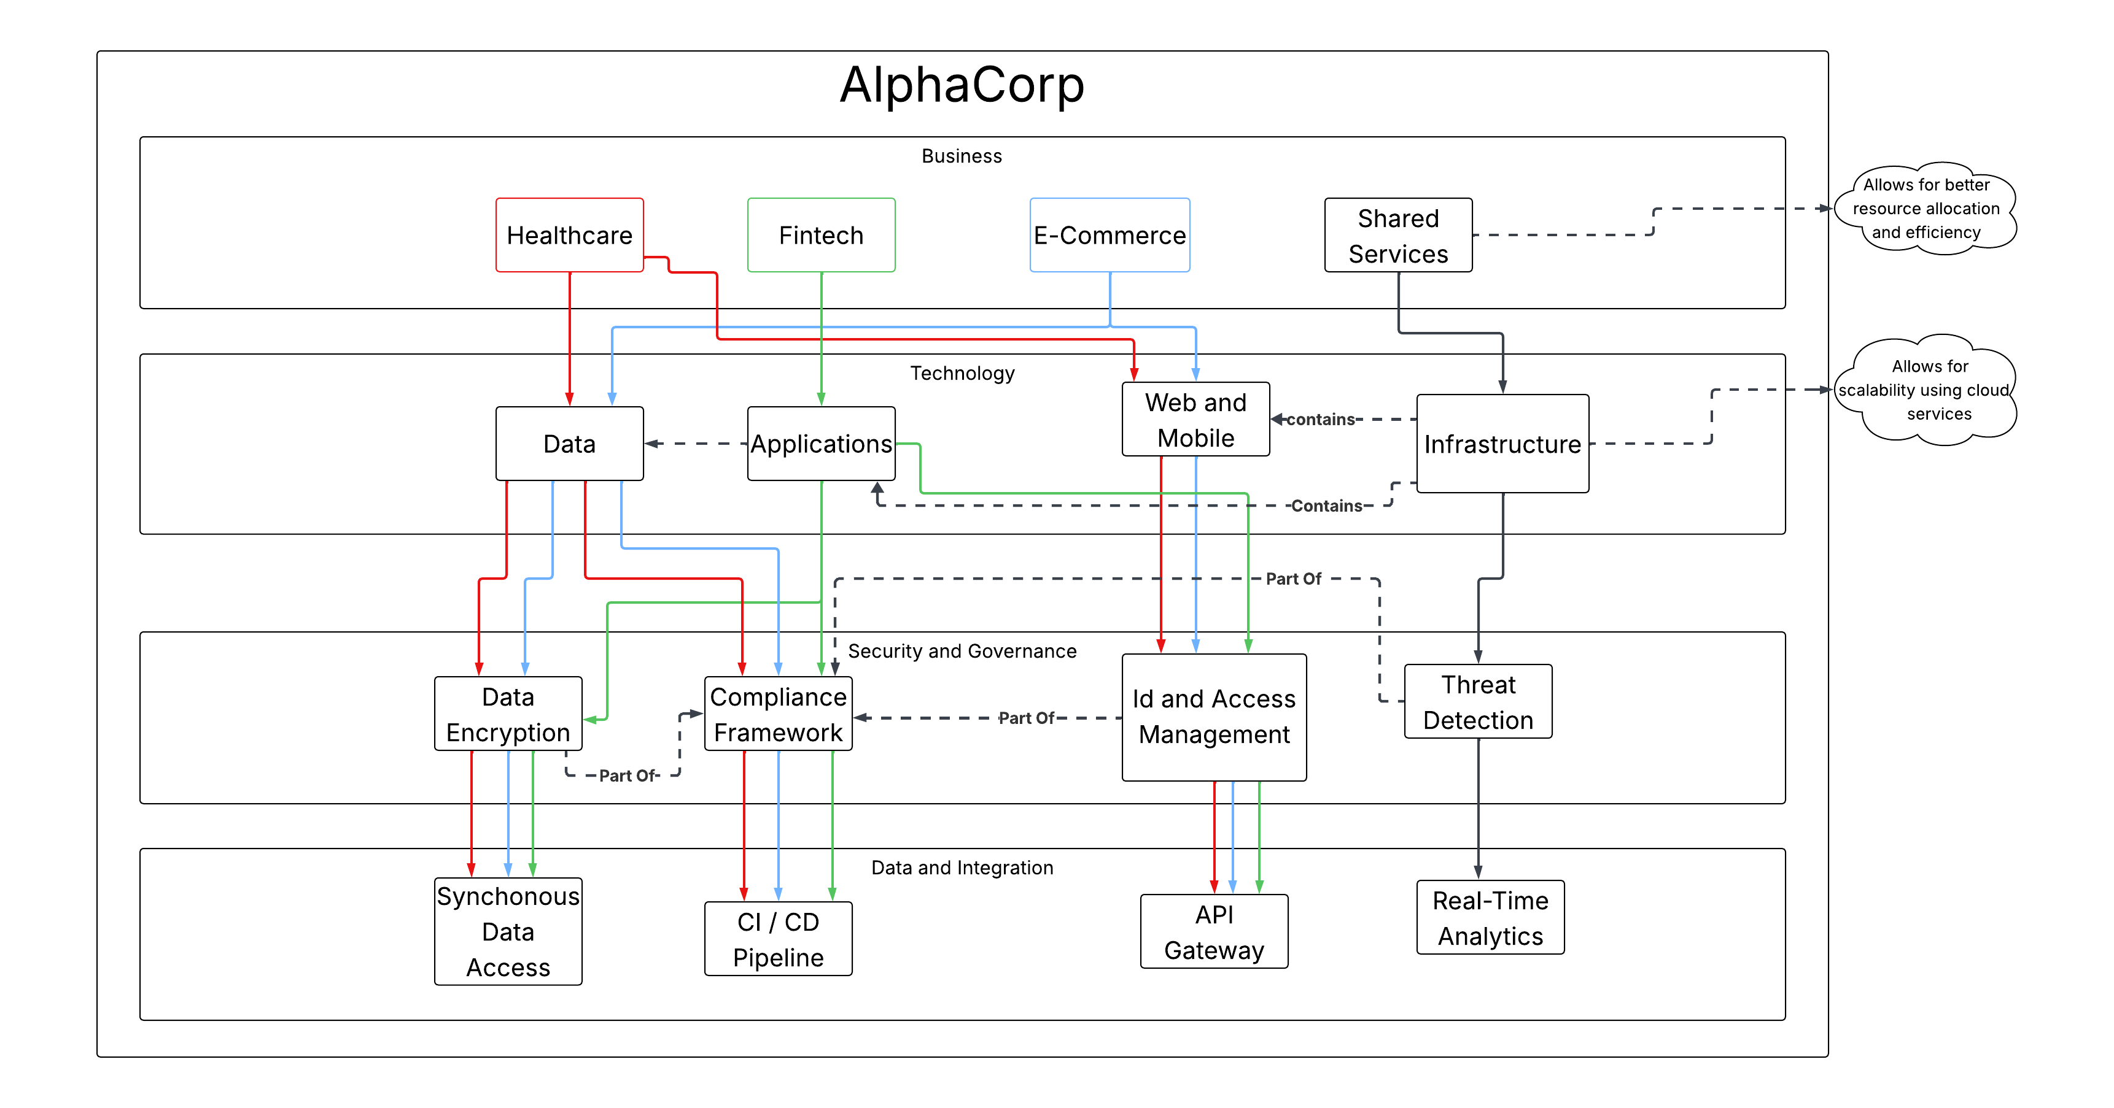
AlphaCorp United
Notes:
To address the needs and gaps of the current state of the business, a unified architecture framework is being proposed, as you can see in this composite diagram. We have included a shared services section in the business layer. This is to allow for better resource allocation and cost savings, as we consolidate redundant infrastructure and other resources. In our technology layer, we propose having a central data lake for all of AlphaCorp’s generated data. This not only provides the cost savings, but it makes it easier to perform analytics and implement security and AI. We also propose migrating to the cloud for all infrastructure to provide the scalability that is needed for future growth. In our security and governance layer, we propose a unified standard compliance framework, which includes standard data encryption protocols as well as ID and access management that is consistent across all business units and threat detection as well. Lastly in our data layer we propose creation of content integration / content delivery pipeline guidelines, so that the language that is used is consistent across all divisions. We also want to implement real time analytics across the board, with synchronous data access and centralized API gateways.

Slide 15
Enterprise Architecture Framework

Slide 16
EA Framework – What the Doctor Ordered
Allows the company to align its IT infrastructure with its business goals.
Determine what systems and areas are at risk.
Integrate systems across departments.
Reduces training and redundancy.
Creates a foundation that utilizes data effectively.
Continued growth, scalability, and adaptability of the business.
Notes:
An enterprise architecture program allows the company to align its IT infrastructure with its business goals, determine what systems and areas are at risk, integrate systems across departments to reduce training and redundancy, and create a foundation that utilizes data for continued growth, scalability, and adaptability of the business.

Slide 17
EA Framework Overview
Zachman Framework
The Open Group Architecture Framework (TOGAF)
Structured model for understanding and organizing the architecture of an enterprise
Broken down into a grid with rows representing the different roles in the business and the columns representing the different aspects.
The columns are What, How, Where, When, Who, and Why.
The rows are broken down into Planner’s view, Owner’s view, Designer’s view, Engineer’s view, Technician’s view, and the User’s view.
TOGAF is one of the most widely used frameworks today by business
It provides the blueprint but also the tools to implement and maintain the framework.
TOGAF keeps the business goals in mind and works to align the infrastructure.
At the center of TOGAF is the architecture development method or ADM.
It includes eight phases which are cyclical in nature.
In the middle of the circle is requirements management to represent that these are always driving each part of the cycle.
Notes:
The Zachman Framework is a structured model for understanding and organizing the architecture of an enterprise. It is broken down into a grid with rows representing the different roles in the business and the columns representing the different aspects. The columns are What, How, Where, When, Who, and Why (3). The rows are broken down into Planner’s view, Owner’s view, Designer’s view, Engineer’s view, Technician’s view, and the User’s view
TOGAF is one of the most widely used frameworks today by business. It is complete in the sense that it provides the blueprint but also the tools to implement and maintain the framework. TOGAF keeps the business goals in mind and works to align the infrastructure with them. At the center of TOGAF is the architecture development method or ADM. It includes ten phases which are cyclical in nature. In the middle of the circle is requirements management to represent that these are always driving each part of the cycle.

Slide 18
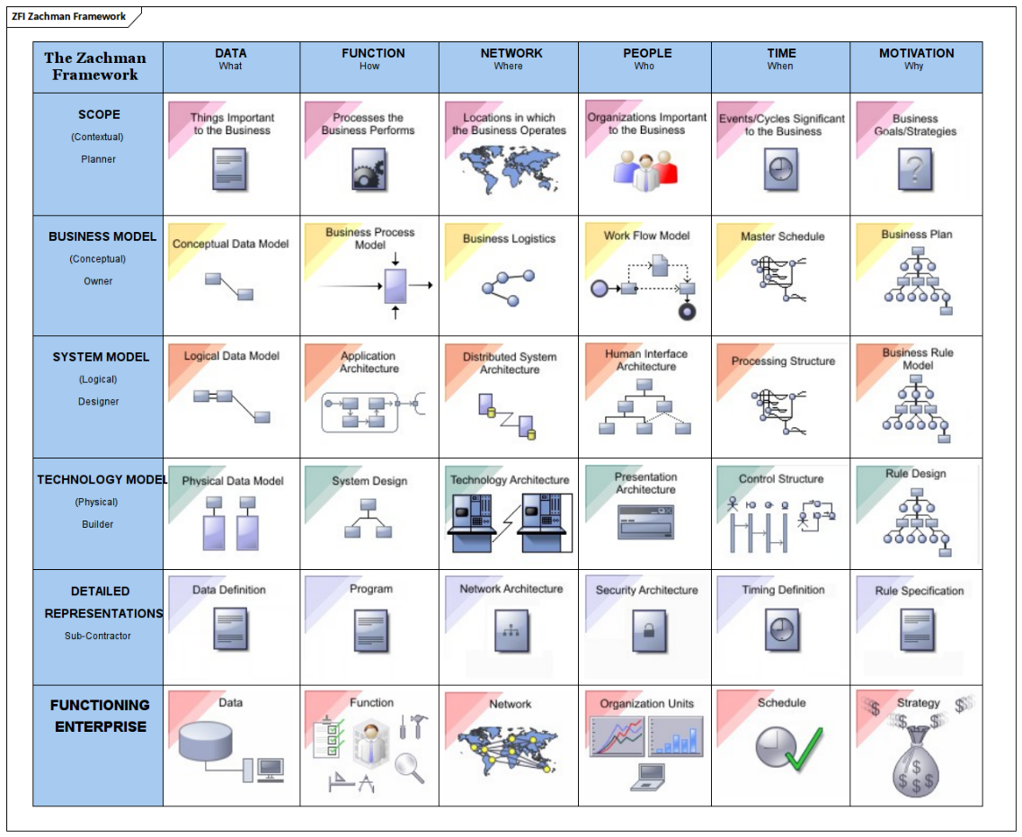
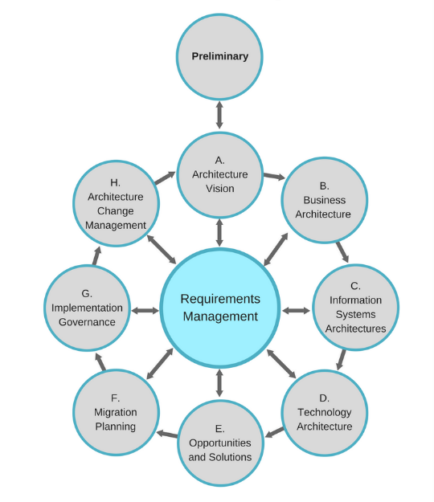
Visual Representations

Slide 19
EA Framework Comparison
 | Zachman | TOGAF (The Open Group Architecture Framework)
Methodology | Provides descriptions of current state applications and architecture. | Provides structure and a complete guide.
Scope | Current State. Focus on classifying and identifying. | Current and future state. Covers business, data, technology, and security.
Strength | Universally applicable to any business. Great for audits of the current state. | Proven step by step end to end process for implementing change. Many resources are available for use.
Weakness | Does not provide steps for implementation or migration of technologies. | Tends to be complex. Requires skilled individuals to manage the framework.
Complexity | Low, especially compared to TOGAF. | High due to the larger scope that it covers.
Adaptability | Low. The grid tends to be static, requiring a full rework when changes are needed. | High. TOGAF can be tailored to fit business needs. Items can be changed as the goals of business change.
Scalability | Can ramp up complexity as scope of the enterprise increases. | Very scalable to meet small or large scale changes.
Efficiency | Great for audits but provides no efficiency gains for implementation. | Provides efficiency for managing change by utilizing the 8 phases of the process.

Slide 20
EA Framework Comparison
Key
Completely Meets Needs
Partially Meets Needs
Does Not Meet Needs
 | TOGAF | Zachman
Data Storage | First four phases directly highlight issues and create plan for migration. | No change implementation methodology.
No Standard Communication Protocol | Defining of enterprise-wide goals is addressed in Architecture Vision phase. | Provides no tools or mechanisms to create or select new protocols
Limited Scalability | Is an iterative framework with all phases being driven by the overall business goals. | No change implementation methodology.
Wasteful Expenditures | First three phases highlight the waste and outdated software that resides in AlphaCorp. | Provides no tools or mechanisms to create or select new protocols.
Outdated Software | First three phases highlight the waste and outdated software that resides in AlphaCorp. | In the Zachman grid the columns Where, What, and How should provide a full view of the outdated software and applications.
Budget Constraints | TOGAF considers requirements management throughout all 8 stages. Prioritization of critical migration is a part of the cycle so AlphaCorp can stay within budget. | Low initial costs but does not provide guidance on migration and architecture change.
Adaptability | Is an iterative framework with all phases being driven by the overall business goals. Can adapt easily to new goals. | Is not an iterative framework, so does not have the ability to adapt to new business criteria.

Slide 21
EA Repository Tool
OrbusInfinity published by Orbus software.
The tool that has the highest rating in the three main industries of finance, healthcare, and e-commerce.
Year | Quarter | Summary | Budget
One | One | Select enterprise team, train the team in TOGAF principles and OrbusInfinity. | $250,000 – Software License $500,000 for updating legacy systems, data migration tasks, and training.
 | Two and Three | TOGAF phases A-E perform an audit of existing technology to highlight redundancy and legacy systems that need to be updated Prioritize critical systems using the market research that was provided along with the business goals. Look for cost savings by consolidating data under one or two different vendors, while still maintaining data integrity and security where it is needed. Begin the pilot phase of updating and integration of new systems.
 | Four | Continue to perform data migration tasks and more labor-intensive system updates first with the extended budget.
Two | N/A | Continue to migrate and integrate new technologies as able by budget constraints. | $100,000 /yr
Notes:
There are many tools out there that provide functionality and work alongside The Open Group Architecture Framework. The company Gartner has amassed a collection of widely used repository tools and ranked them based on user reviews. By filtering by AlphaCorp’s three main industries of finance, healthcare, and e-commerce, the tool that has the highest rating is the OrbusInfinity published by Orbus software.
***********Talk Through Table**********************************
No new heads will need to be added as the existing IT staff will be re-purposed to perform these tasks. A skeleton crew will be in place to ensure that the business runs at 100% while systems are being updated.

Slide 22
Predictive Modeling

Slide 23
Predictive Modeling Integration
Predictive Modeling
Model Predictive Control Framework
Time Series Forecasting
Machine Learning Anomaly Detection
Three Parts for Comprehensive Coverage
Anomaly Detection Predictive Model (Machine Learning)
Used for cybersecurity, failure detection and other bottlenecks within the multi-cloud infrastructure.
Time Series Forecasting Predictive Model
Used for predicting seasonal market patterns for AlphaCorp’s e-commerce and fintech business units and to predict demand for infrastructure resources (automatic scaling) and if additional network bandwidth is needed.
Model Predictive Control Framework
Allows Predictive models to work continuously and update themselves based on previous predictions they have made.
Creates a feedback loop that is always improving the accuracy of the predictions.
Increases the efficiency of resource allocation.
Notes:
The classification models would be for the task of anomaly detection, which would cover the threat protection portion of the security gap. What the model does is notify and call out data points that lie outside of normal activity within a process. A use case would be flagging access patterns that do not fall under normal activity.
Time series models do well with historical and seasonal data, as they treat time as one of the axes for data analysis. Autoregressive Integrated Moving Average (ARIMA) is a specific time series model that excels at forecasting future values based on the historical data. This relates to AlphaCorp’s e-commerce business sector and the seasonality of markets.
In addition, predictive models are great, but they inherently do not lead to actions by themselves. To create an effective dynamic resource allocation plan, additional architectures are needed such as model predictive control. This framework takes the predictions from the models and automatically acts on them.

Slide 24
Implementation
Phase | Timeframe | Summary | Budget
Phase 1 | Two months | The first phase will be for planning the project as well as ensuring the quality of the existing data. There will be the consolidation of existing data, cleaning of existing data, and collaboration across departments with key stakeholders. | $25,000
Phase 2 | Four months | The second phase is where some models will be implemented in a piloted approach. The recommendation is that at least one time series and one anomaly model get deployed in this phase. | $75,000
Phase 3 | Four months | The third phase is where AlphaCorp scales up their predictive models and begins to implement them into the model predictive control framework. Development of automation and automation policies and guidelines also occurs at this time. | $75,000
Phase 4 | Two months | The fourth and final phase is where the continuous monitoring for modeling drift happens. Predictive models can drift away from accurate predictions as business conditions change over time. AlphaCorp should create a process for retraining their models to ensure that they stay accurate over time. | $25,000
Notes:
The recommendation is a phased approach that is consistent with industry standards for project management in an effort to reduce the risk involved and provide value for AlphaCorp. This allows for more funds to be used during the more intensive resource phases in the middle while still allowing funding for continuous development after initial deployment.

Slide 25
Risk Analysis
Risk | Impact | Solution
Organizational pushbacks and lack of faith in predictive models. | Little to no adoption by information technology and other departments. | Model interpretability and explainability are goals early in the project (phase two).
Overall gaps in data security protocols. | Lead to the release of sensitive data, causing potential government fines and loss of trust with the customer base. | Data anomaly models will be implemented to help AlphaCorp be proactive with security.
Model inaccuracies over time as business conditions change and vary. | Leads to incorrect and poor use of resources, operational inefficiencies, and loss of trust in the models internally. | Proposed continuous monitoring and regular retraining of models based on updated business conditions.
Notes:
There are some critical risks that have been identified that need to be addressed by the recommendations for this project, as shown in the table here.

Slide 26
KPIs and Monitoring
Mock KPI Dashboard
Cloud Expenditure | Current Month | Previous Month | % Change
 | 13K | 16.5K | 21.1
Cost / Cloud Transaction | $10
Number of Security Incidents | 5
Data Recovery Time (DRT - min) | 5
Predictive Models | Model Type | False Positives | False Negatives
 | Time Series | 2 | 3
 | ML Anomaly | 1 | 0
Overall Predictive Model Accuracy | 89%
Resources | Application | Utilization Rate | Latency (ns)
 | App 1 | 65% | 98
 | App 2 | 45% | 35
Notes:
The recommendation is that a continuous monitoring and evaluation system be put into place for this project. These metric and monitoring recommendations come from case studies and industry standards in the banking and healthcare fields. The recommendation is to have four categories of KPIs for this project based on the specific situation for AlphaCorp. The first category is cost, with a KPI that looks at current spending in both cloud environments and compares it to previous spending on a monthly basis. An additional cost KPI should be created for a cost per transaction ratio. The next category of KPIs is compliance. Two critical KPIs that need to be implemented in this category are number of security incidents and data recovery time. The next category of KPIs is predictive models. Two specific KPIs in this category should be the accuracy of the predictions and the frequency of false positives and false negatives from the anomaly detection model. The last category of KPIs is performance of operations. Two specific indicators in this category should be resource utilization rate and application latency. With these categories there should be a solid coverage of metrics to determine the success and health of the predictive modeling system. A dashboard will be created to continuously monitor these KPIs in real time. As mentioned above, the dashboard will include KPIs that monitor the models and the health of the infrastructure which provides a complete overview of the process. The monitoring system will also allow manual intervention from IT to retrain and keep improving the models. This is considered industry best practice. By implementing monitoring patterns, AlphaCorp can help mitigate data transfer limits by scheduling larger data migrations during non-peak times which will lower resource utilization and ensure that they are not exceeding the limits set by their cloud contracts.

Slide 27
Cybersecurity

Slide 28
Inventory – Cyber Asset
Asset # | Name | Location | Ownership | Configuration | Criticality
A1 | Firewall | Branch Offices | Cyber Security Team | Outdated technology | High
A2 | Servers | On premise | IT Architecture Team | Legacy | High
A3 | E-commerce site | Cloud (public) | E-commerce division IT | Newest technology and software on public cloud. | High
A4 | Computers and laptops | Employee operated (global deployment) | IT | Imaged by AlphaCorp IT. | Medium
A5 | Patient Records | Cloud (private) | Healthcare Division IT | Software on private cloud. HIPAA compliant. | High
A6 | Payment Processing | Cloud (public) | Fintech Division IT | Newest technology and software on public cloud. | High
Notes:
To determine what cybersecurity measures need to be invested in, an audit of the inventory of the current cyber assets at AlphaCorp is needed. This is an important step for creating an effective investment plan. Included in the inventory assessment are hardware, software, and items that interact with data and other information systems. The Zero Trust framework provides the guide to creation of the below catalog. The catalog provides attributes of ownership, location, configuration and criticality to each asset.

Slide 29
Inventory – Information Asset
Asset # | Data Type | Owner | Classification | Linked Cyber Asset
IA1 | Patient Health Information | Healthcare Division | Restricted and Confidential | A1 A5
IA2 | Credit Card Payment Info | Fintech Division | Restricted and Confidential | A6
IA3 | AlphaCorp Intellectual Property | AlphaCorp Leadership | Restricted | A1 A4
IA4 | AlphaCorp Financial Records | AlphaCorp Leadership | Confidential | A1
IA5 | Customer Payment Information | E-Commerce Division | Confidential | A3
Notes:
Our next step is to classify and categorize our information assets. To have an effective cyber security umbrella it needs to be risk based and focus on the data. The data that relates back to business value and that needs to be secured is the focus here. This joins the cyber security of AlphaCorp with their specific business goals creating a best practice in enterprise architecture. The data is classified based on confidentiality, sensitivity, and how important it is to the business. This step is required to create a Zero Trust Architecture as it will provide the justification for data access. Highlighting owners of each data section creates accountability which is a key aspect of risk management. The last piece is to link the associated information asset to the cyber asset to provide a clear picture of the business and where security is needed the most.

Slide 30
Compliance Assessment
Requirement | Asset / Process | Status | Gap
GDPR (E-Commerce) | IA2 - Credit Card Payment Info IA5 - Customer Payment Information A3 – E-commerce site | Partial | Data integrity concerns include vulnerabilities in the system. No documented policies for notifying of a data breach.
HIPPA (Healthcare) | IA1 - Patient Health Information A5 - Patient Records system | Partial | Legacy servers combined with no auditing process lead to partial noncompliance.
PCI-DSS (Fintech) | A6 - Payment Processing IA2 - Credit Card Payment Info IA5 - Customer Payment Information | Compliant | End-to-end encryption ensures compliance with this sensitive financial data.
NIST (Security Framework) | A1-A6 IA1-IA5 | Non-compliance | No consistent penetration testing coupled with outdated infrastructure and no continuous monitoring processes in place lead to non-compliance here.
Notes:
The compliance and regulatory framework map compare the current processes and assets in AlphaCorp against the legal and regulatory requirements that are standard in the healthcare industries, fintech, and e-commerce. The goal is to reinforce the enterprise architecture philosophy of compliance by design. By providing a direct look at the cyber assets and regulations required, the gaps in the current security profile can be addressed effectively.

Slide 31
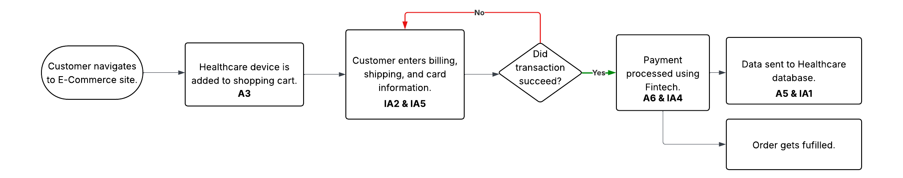
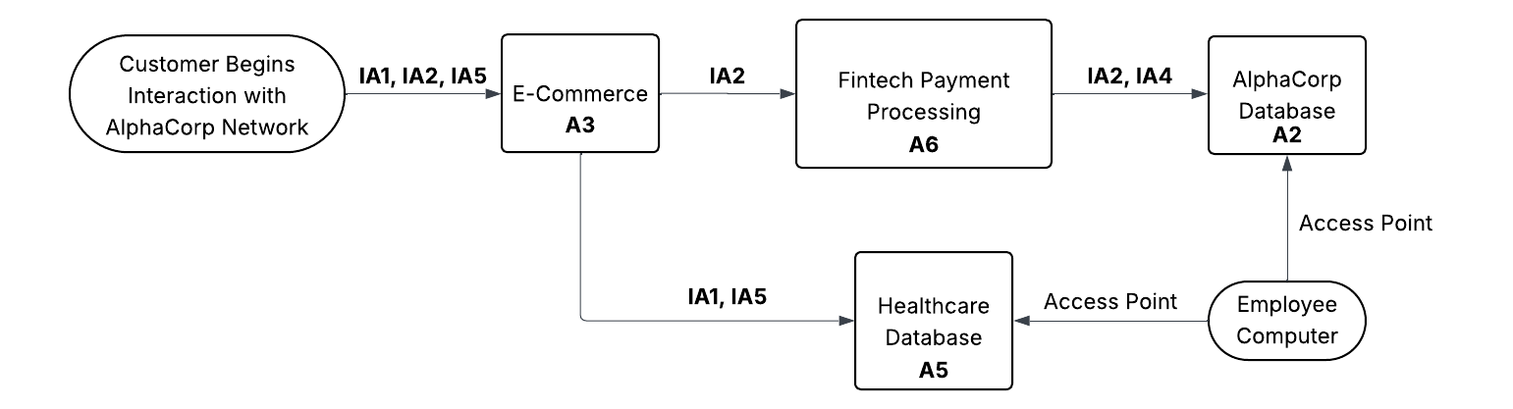
Business Process Map and Data Flow Diagram
Notes:
Next is to map the operations of AlphaCorp’s business with the cyber assets to continue the integration of security into the overall enterprise architecture. The goal is the visualization of the important data moves and changes through business systems. With the mapping of business processes, bottlenecks and failure points become apparent and is a core philosophy of a Zero Trust framework. It allows AlphaCorp to create and implement granular controls in security. The map below shows a process that connects all three of AlphaCorp’s main domains together.
As can be seen in the diagram, this example flow connects all three core businesses of AlphaCorp together, highlights some risks and dependencies, and helps to combine IT with the goals of AlphaCorp’s leadership team. Cyber assets A3, A6, and A5 all support this process that could be a core profit generator for the company. Cloud infrastructure, APIs, and databases are all necessary for this process to work and highlight the need for security between cloud environments. Information assets IA1, IA2, IA4, and IA5 are also needed for this process. Those information assets represent high risk within this business process, as any kind of threat at any point in the process could lead to financial and image loss for AlphaCorp.
This diagram highlights the movement of data across AlphaCorp in relation to the business process described in the previous section of this report. This visualization shows where the data is processed, accessed, and stored. This is another component to properly place encryption and access polices.
The above diagram shows how the sensitive data flows through the hybrid cloud infrastructure that AlphaCorp has deployed. The flow of IA2 through the public cloud e-commerce site to the fintech payment processing into the private cloud AlphaCorp database shows a critical path that requires many security features to remain compliant and safeguard the sensitive information. Similar security measures need to be in place for the flow of IA1 and IA5 from the customer to the healthcare database. Employees accessing these databases also highlights internal threat risks and should adhere to principals of least access.

Slide 32
Critical Linkages
Asset # | Information Asset | Connection
A2 – Private Servers | IA1 - Patient Health Information IA3 - AlphaCorp Intellectual Property IA4 - AlphaCorp Financial Records | A2 acts as the storge of these information assets. A security breach of A2 puts all core data at risk.
A1 - Firewalls | IA1 - Patient Health Information IA5 - Customer Payment Information | A1 acts as the network access point for these information assets. Outdated firewalls represent a security risk for unauthorized access of data in transit.
A4 - Computers and laptops | IA1 - Patient Health Information IA2 - Credit Card Payment Info IA3 - AlphaCorp Intellectual Property IA4 - AlphaCorp Financial Records IA5 - Customer Payment Information | An employee laptop acts as an access point to all of these information assets. A stolen or compromised computer could lead to theft of IA3, or other sensitive customer information and data.
A6 - Payment Processing | IA2 - Credit Card Payment Info | A6 directly interacts and processes IA2. An architecture failure here has a direct impact on potential sales and customer trust in AlphaCorp.
Notes:
Next a linkage model is created to provide an interpretable connection between the information and technology assets at AlphaCorp. It allows for visualization of the link between the business and infrastructure which is a core component of a risk informed enterprise architecture. By creating linkages in this way, we are provided with quantifiable measures of the impact on the business a cyber-attack, data breach, or other architectural failure will have. This is a core philosophy of NIST based risk assessment. As shown in the linkage model above, asset A2 and asset A4 present the most risk in the fact that they directly interact with multiple information assets. A2 is more important however because it is a centralized location that stores all critical data that AlphaCorp has. Any breach or failure here would be catastrophic to the organization, whether that be from government fines, financial loss, and loss of customer trust leading to customers going to competitors instead. A1 highlights a need to tighten perimeter security as it could lead to a direct access point to critical data in transit.

Slide 33
Risk And Vulnerability
Risk # | Vulnerability | Asset # | Likelihood | Impact | Level | Current State
R1 | Firewall is outdated. | A1 - Firewalls IA1 - Patient Health Information IA5 - Customer Payment Information | High | Theft of sensitive financial and health data. Insertion of ransomware into AlphaCorp’s network. | High | Basic filtering of access based on legacy technology.
R2 | No continuous training of staff in security protocols. | A4 - Computers and laptops IA1 - Patient Health Information IA2 - Credit Card Payment Info IA3 - AlphaCorp Intellectual Property IA4 - AlphaCorp Financial Records IA5 - Customer Payment Information | Medium | Opens up AlphaCorp to internal threats. Also has the potential for malware and stolen data such as IA3. | Medium | Organization currently deploys two factor authentication policies on all devices as well as providing initial training for employees.
R3 | Legacy servers without security patches. | A2 – Private Servers IA1 - Patient Health Information IA3 - AlphaCorp Intellectual Property IA4 - AlphaCorp Financial Records | High | Data breach or architectural failure leading to government fines, financial loss, and loss of customer trust. | Critical | None
R4 | No consistent schedule for penetration testing. | A3 - E-commerce site A5 - Patient Records A6 - Payment Processing IA1 - Patient Health Information IA2 - Credit Card Payment Info IA5 - Customer Payment Information | Medium | Potential for different cloud server configurations that have different security umbrellas in different domains, leading to noncompliance and vulnerabilities. | Medium | AlphaCorp has an end-to-end encryption policy to protect data.
Notes:
This risk and vulnerability assessment is another part of the NIST risk assessment process. The creation of the linkage model in the previous step will aid in the creation of the risk and vulnerability assessment in this section. The assessment will create a measure of how much risk is involved based on factors like likelihood and overall business impact. It provides AlphaCorp with a tool to properly allocate resources in a way that will be the most effective.

Slide 34
Investment Prioritization
Priority Level (1 – high, 5 – Low) | Description | Business Goal | Risks | ROI
1 | Update legacy systems and migrate data to cloud infrastructure. | Cost optimization and scalability. | R3 | High ROI. Updating these systems and migrating data to the cloud mitigates the most critical risk area that AlphaCorp has. Additionally it provides cost savings through consolidation of data storage as well as the inherent scalability of a cloud service provider.
1 | Update firewall hardware and technology. | Cybersecurity enhancement | R1 | High ROI. Updating the firewalls lessens the likelihood of ransomware, malware, and other unauthorized access to core data.
2 | Continuous monitoring and regular penetration testing. | Cybersecurity enhancement and compliance. | R4 | Med ROI. Continuous monitoring allows the org. to notice and patch vulnerabilities before they happen reducing the potential of negative financial impact.
2 | Zero Trust Architecture model for cyber security. | Cybersecurity enhancement | R1 R2 R4 | Med ROI. Adopting this philosophy will provide long-term benefits of a secure network and infrastructure for AlphaCorp and is industry standard.
3 | Ongoing security training for employees. | Cybersecurity enhancement and resource allocation. | R2 | High ROI. Training the employees to act as another layer of security defense is an easy way to better protect your network without a significant technological investment.
Notes:
The investment plan is put together by combining the information from the previous process maps and classifications done in this report. They are put in order based on the level of risk to AlphaCorp, while considering the impact to the business and the potential return on investment. Below is the formula used to estimate the ROI:
$$ROI = \frac{(Risk Reduction Value + Compliance Cost Avoidance)}{Investment Cost}$$

Slide 35
Product Development Integration - Healthcare

Slide 36
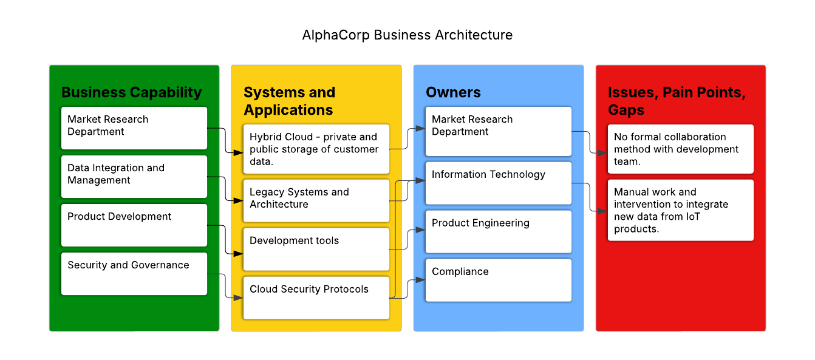
Business Architecture – Healthcare Product Development
Notes:
When it comes to product development in relation to healthcare, AlphaCorp has several business capabilities that have different systems, applications, owners, pain points and gaps. The first of these is the market research department. This department is responsible for providing information on current market conditions to help facilitate the identification of new potential products for AlphaCorp. This business function is owned by the product management department and utilizes the hybrid cloud infrastructure of AlphaCorp, having customer data stored in the cloud and on premises servers. An identified gap of this process is that currently there is no collaboration between the market research group and the rest of the product development team, leading to isolation during the development cycle. Next business capability would be data integration and management. This would be ensuring that the data from customer’s IoT health devices is properly stored and combined with the existing data that AlphaCorp has. This function is owned by the information technology department, and currently there is a mix of legacy and non-legacy architecture here. Another gap identified is that there can be manual and additional work required to ensure that the data is properly integrated to new and legacy systems. The next capability is the ability to develop new products. This function is owned by the product engineering department which is probably a sub department of IT. They utilize development tools for things like code review, version control, and other things like that. The last business capability that was highlighted for the development of a healthcare product was applying data security and overall governance. This function would be owned by the compliance department. They currently employ a cloud security model that can provide additional security of this sensitive data.

Slide 37
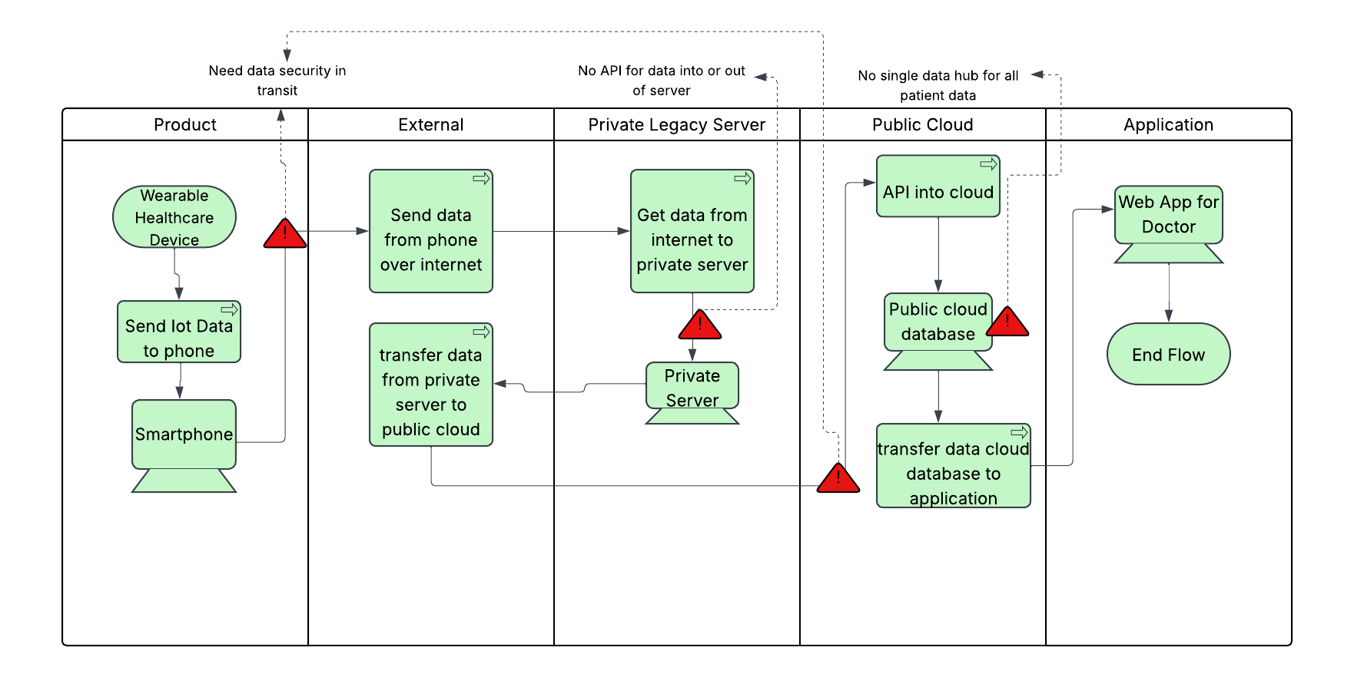
Technology Architecture – Healthcare Product Development
Notes:
We start with the product that we are hoping to develop which is a wearable IoT device that collects healthcare data and sends it to a phone application via Bluetooth. Next, we want the phone app to send that data over the internet to the private server which hosts the database where the data is located. When we send data over the internet, we need to ensure that it is encrypted in transit on the way to the database and at rest in the database itself. This is also where AlphaCorp should develop the APIs to ensure that secure transfer of data. Next, we want another API to transfer the data from the private server into the public cloud server. Moving forward AlphaCorp should also consider creating a singular, scalable cloud database for their healthcare patient data instead of each product having its own data location. Lastly this data is transferred from the cloud network to the web application for the Doctor to utilize to assist with patient diagnosis and other care activities.

Slide 38
Gap Identification – Healthcare Product Development
Gap | Development Impact | Industry Standard
No formal collaboration between market research and product development departments. | Delays in product development. Slow to adopt new trends in the market, putting AlphaCorp behind on innovation. | Creating a unified EA cycle for product development that identifies all key stakeholders.
Manual process of integrating IoT data with existing databases and applications. | Increases development costs and slows down the entire development process. | Creating APIs to integrate and move data between devices, applications, and the cloud network.
Data is stored in separate databases based on the application. | Prevents using data for real time metrics or creating enhanced AI treatment plans as data is scattered. This can also lead to security inconsistencies. | Creating a central data repository, with appropriate security protocols and limited access based on job roles.
No end-to-end data security. | This can lead to data leaks, causing customers to lose trust in AlphaCorp and its products. Less customers means less funding for future development. | End to end encryption using standards for data at rest and in transit.
Notes:
Now that gaps have been identified by analysis of the business and technology architecture, the next steps are to compare the current state of AlphaCorp’s healthcare product development against the industry standards.

Slide 39
Healthcare Product Development Roadmap
Phase 1: Ideation and Conceptualization
Product idea will be compared and proven viable against the market research.
Involvement with key stakeholders to determine the return on investment.
Phase 2: Planning and Strategy
Budget allocation and planning take place.
Confirm the enterprise architecture strategy.
Scope of the project will be determined and finalized.
Risk assessment will be performed.
Phase 3: Design and Prototyping
User experience designed and validation of the technical architecture.
Basic prototype of the product will be produced.

Slide 40
Healthcare Product Development Roadmap
Phase 4: Development
Features are continually added to the device, ensuring that there is a minimum viable product by year end.
Tested and adjusted depending on the feedback.
Data integration APIs will be developed.
Central database will be developed.
Phase 5: Quality Assurance
Product is tested to see if it meets data security requirements.
Comprehensive testing of the new APIs for data load and proper ingestion.
Phase 6: Deployment
Product gets launched incrementally.
Training of sales and marketing departments.
Monitoring of system performance and stability.
Phase 7: Post-launch and Optimization
Device is monitored, and user feedback is consolidated and analyzed.
Software updates and other fixes are pushed.
Inclusion of industry innovations, such as AI for patient diagnosis and blockchain for additional security in V2.

Slide 41
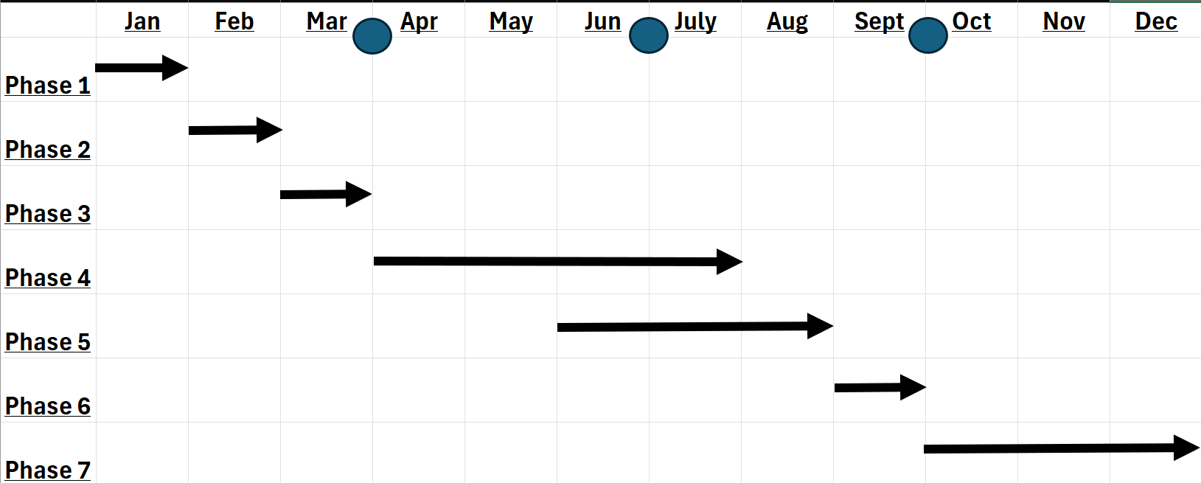
Healthcare Product Development Roadmap
Phase 1 - $25,000
Phase 2 - $25,000
Phase 3 - $25,000
Phase 4 - $100,000
Phase 5 – $75,000
Phase 6 - $25,000
Phase 7 – $25,000
Total - $300,000

Slide 42
Solutions

Slide 43
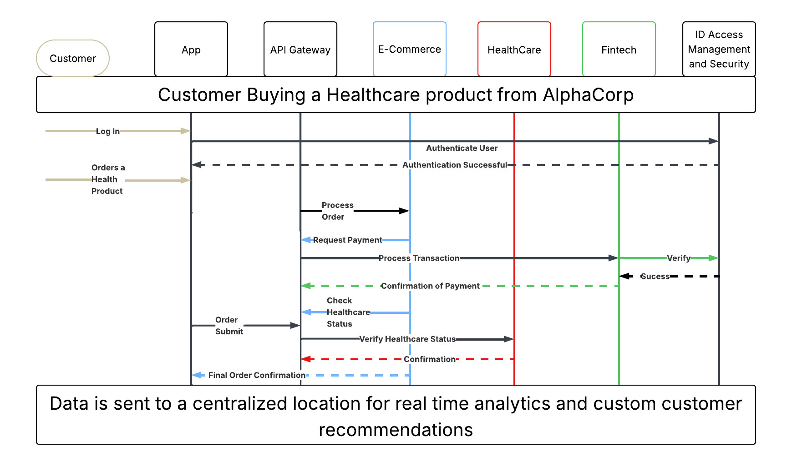
Uniformity In Practice
Notes:
Let’s look at an example case to showcase the proposed uniformity. The data flow diagram will walk us through a scenario where a customer wants to buy a healthcare related product from AlphaCorp. The customer logs into the central app, and their ID gets verified by our ID access management and security protocols. Once verified, the customer browses until they find a healthcare product that they would like to purchase. This order is sent from the API gateway to the E-commerce section which then requests payment information. This information is sent to Fintech which then goes and verifies it with the security processes. After verification, Fintech send confirmation back to the API gateway. The E-commerce section then checks the customer’s healthcare status. This verification goes to the healthcare section of the business, which then sends the confirmation back to the API gateway. After verification of the healthcare status, the E-commerce division sends the final order confirmation to the customer into the application. All this data that is generated from this transaction cycle is sent to the centralized data lake for real time analytics and custom customer recommendations. This sample scenario shows how all three divisions work in unison under a shared enterprise architecture.

Slide 44
Back to the Beginning
Goal | Solution
Industry leader in cybersecurity measures. | A unified standard compliance framework, which includes standard data encryption protocols as well as ID and access management that is consistent across all business units and threat detection as well.
Optimize operational costs. | Shared services and infrastructure, allowing for better resource allocation and cost savings, as we consolidate redundant infrastructure and other resources. In our technology layer, we propose having a central data lake for all of AlphaCorp’s generated data.
Scale operations effectively to support growth. | Migrating to the cloud for all infrastructure to provide the scalability that is needed for future growth.
Notes:
At the end of analysis, AlphaCorp had three main goals that were identified across all three business units in some way, shape, or form. They were to be an industry leader in cybersecurity measures, optimize operational costs, and scale operations effectively to support growth. The unified framework that was provided and discussed effectively addressed and would achieve these main goals for the company.

Slide 45

Next Steps
Create a phased integration and migration plan for transition from legacy to cloud systems.
1
Create a governing body for the compliance and governance framework.
2
Create a beta test on a smaller scale to prove the validity of the proposed approach.
3

Slide 46
Bibliography
Bouchrika, I. (2024, January 2). How to Write Research Methodology: Overview, Tips, and Techniques. Research.com. https://research.com/research/how-to-write-research-methodology
Kotusev, S. (2021, July 1). A comparison of the top four enterprise architecture frameworks | BCS. Www.bcs.org. https://www.bcs.org/articles-opinion-and-research/a-comparison-of-the-top-four-enterprise-architecture-frameworks/
Enterprise Architecture Frameworks: TOGAF, Zachman, SABSA, a. (n.d.). AltexSoft. https://www.altexsoft.com/blog/enterprise-architecture-frameworks-documenting-your-roadmap-to-change/
Federal Enterprise Architecture Framework | CMS. (n.d.). Www.cms.gov. https://www.cms.gov/data-research/cms-information-technology/enterprise-architecture/federal-enterprise-architecture-framework

Slide 47
Bibliography
LeanIX. (n.d.). FEAF – Federal Enterprise Architecture Framework | LeanIX. Www.leanix.net. https://www.leanix.net/en/wiki/ea/feaf-federal-enterprise-architecture-framework
White, S. (2022, May 30). What is TOGAF? An enterprise architecture methodology for business. Www.cio.com. https://www.cio.com/article/228328/what-is-togaf-an-enterprise-architecture-methodology-for-business.html
Estrach, P. (2023, January 11). What is Enterprise Architecture (EA), and Why is it Important? MEGA. https://www.mega.com/blog/what-is-enterprise-architecture-definition
Gartner, I. (2019). Enterprise Architecture (EA) Tools Reviews. Gartner. https://www.gartner.com/reviews/market/enterprise-architecture-tools

Slide 48
Bibliography
Bhatt, A. (2025, August 15). What Will An Enterprise Architecture Tool Cost You in 2025? A Pricing Breakdown. Ardoq.com; Ardoq AS. https://www.ardoq.com/blog/enterprise-architecture-cost-in-2025
Reselman, B. (2020). TOGAF and the history of enterprise architecture. Redhat.com. https://www.redhat.com/en/blog/togaf
Viccars, A. (2024, November 11). Blockchain’s impact on Enterprise Architecture. A new standard in security and transparency. Entasispartners.com; Entasis Partners. https://www.entasispartners.com/blog/blockchains-impact-on-enterprise-architecture-a-new-standard-in-security-and-transparency
Betz, C. (2025, April 2). The Augmented Architect: Real-Time Enterprise Architecture In The Age Of AI. Forrester. https://www.forrester.com/blogs/the-augmented-architect-real-time-enterprise-architecture-in-the-age-of-ai/

Slide 49
Bibliography
Guide to Enterprise Architecture ENTERPRISE ARCHITECT User Guide Series. (2023). https://sparxsystems.com/resources/user-guides/16.1/guidebooks/enterprise-architecture.pdf
White, S. (2020, April 6). What is the Zachman Framework? A matrix for managing enterprise architecture. CIO. https://www.cio.com/article/193229/what-is-the-zachman-framework-a-matrix-for-managing-enterprise-architecture.html
Ardoq. (2024, October 22). What is the Zachman Framework? A Definitive Guide to this EA Standard. Ardoq.com; Ardoq AS. https://www.ardoq.com/knowledge-hub/zachman-framework
The Zachman Framework Main View. (n.d.). Sparxsystems.com. https://sparxsystems.com/resources/gallery/diagrams/architecture/arc-zachman-framework.html
Raza, M. (2020, March 27). TOGAF vs Zachman: What’s The Difference? BMC Blogs. https://www.bmc.com/blogs/togaf-vs-zachman/

Slide 50
Bibliography
Asana. (2024, January 8). Guide to Process Mapping: Definition, How-to, and Tips • Asana. Asana. https://asana.com/resources/process-mapping
Sinur, J., Misiak, Z., & BJ Biernatowski. (2025). Practical Business Process Modeling and Analysis. Packt Publishing Ltd.
Angelo the BA. (2020, October 4). Business Process Modeling BPMN Basics Tutorial with Draw.IO (Free Visio Alternative). YouTube. https://www.youtube.com/watch?v=e9wANApZXL8
Building a Business Architecture. (n.d.). Lucidchart. https://www.lucidchart.com/blog/building-a-business-architecture
DTUdk. (2012, February 15). 03-2/4: Integrated Product Development. YouTube. https://www.youtube.com/watch?v=VJTA6bT_PRk

Slide 51
Bibliography
What is Predictive Modeling? An Introduction | Splunk. (2025). Splunk. https://www.splunk.com/en_us/blog/learn/predictive-modeling.html?301=/en_us/data-insider/what-is-predictive-modeling.html
Ali, R. (2020, September 22). Predicting Your Business’s Future. Oracle NetSuite. https://www.netsuite.com/portal/resource/articles/financial-management/predictive-modeling.shtml
dotData. (2022, September 22). Types of Predictive Models (& How They Work). DotData. https://dotdata.com/blog/types-of-predictive-models-how-they-work/
Pratama, I. N., Dachyar, M., & Pratama, N. R. (2023). Optimization of Resource Allocation and Task Allocation with Project Management Information Systems in Information Technology Companies. TEM Journal, 12(3), 1814–1824. https://doi.org/10.18421/tem123-65

Slide 52
Bibliography
Morariu, C., Morariu, O., Răileanu, S., & Borangiu, T. (2020). Machine learning for predictive scheduling and resource allocation in large scale manufacturing systems. Computers in Industry, 120, 103244. https://doi.org/10.1016/j.compind.2020.103244
Al-Ghamdi, M., Chester, A., He, L., & Jarvis, S. (n.d.). DYNAMIC RESOURCE ALLOCATION AND ACTIVE PREDICTIVE MODELS FOR ENTERPRISE APPLICATIONS. https://doi.org/10.5220/0003388705510562
Glaser, V. L., Omidvar, O., & Safavi, M. (2023). Predictive Models Can Lose the Plot. Here’s How to Keep Them on Track. MIT Sloan Management Review, 64(4). https://sloanreview.mit.edu/article/predictive-models-can-lose-the-plot-heres-how-to-keep-them-on-track/
Schwartz, E. I. (2010, December 13). Predictive Modeling Isn’t Magic. MIT Technology Review. https://www.technologyreview.com/2010/12/13/198480/predictive-modeling-isnt-magic/

Slide 53
Bibliography
Zewe, A. (2023, February 13). Efficient technique improves machine-learning models’ reliability. MIT News | Massachusetts Institute of Technology. https://news.mit.edu/2023/improving-machine-learning-models-reliability-0213
Banking and Capital Markets | Deloitte US. (2025). Deloitte. https://www.deloitte.com/us/en/Industries/banking-capital-markets/about.html
Ciocan, D. F., & Farias, V. (2012). Model Predictive Control for Dynamic Resource Allocation. Mathematics of Operations Research, 37(3), 501–525. https://doi.org/10.1287/moor.1120.0548
Philips. (2020, June 12). Predictive analytics in healthcare: three real-world examples. Philips. https://www.philips.com/a-w/about/news/archive/features/20200604-predictive-analytics-in-healthcare-three-real-world-examples.html

Slide 54
Bibliography
Thakore, A. (2020). ESTABLISHING AN ENTERPRISE SECURITY ARCHITECTURE. ResearchGate. https://doi.org/10.13140/RG.2.2.18442.18882
CISA. (2023). Zero Trust Maturity Model. https://www.cisa.gov/sites/default/files/2023-04/zero_trust_maturity_model_v2_508.pdf
Kerman, A., Borchert, O., Rose, S., Division, E., & Tan, A. (2020). IMPLEMENTING A ZERO TRUST ARCHITECTURE. https://www.nccoe.nist.gov/sites/default/files/legacy-files/zta-project-description-final.pdf
How to Improve Cyber Security with Enterprise Architecture > Business Analyst Community & Resources | Modern Analyst. (n.d.). Www.modernanalyst.com. https://www.modernanalyst.com/Resources/Articles/tabid/115/ID/5249/How-to-Improve-Cyber-Security-with-Enterprise-Architecture.aspx

Slide 55
Bibliography
Cloud Security Technical Reference Architecture Federal Risk and Authorization Management Program. (2022). https://www.cisa.gov/sites/default/files/publications/Cloud%20Security%20Technical%20Reference%20Architecture.pdf
Quinn, S., Ivy, N., Barrett, M., Feldman, L., Witte, G., & Gardner, R. K. (2021). Identifying and Estimating Cybersecurity Risk for Enterprise Risk Management. Identifying and Estimating Cybersecurity Risk for Enterprise Risk Management. https://doi.org/10.6028/nist.ir.8286a
Cybersecurity and Infrastructure Security Agency. (2022). Guide to Getting Started with a Cybersecurity Risk Assessment Publication: 2022 Cybersecurity and Infrastructure Security Agency. https://www.cisa.gov/sites/default/files/2024-09/24_0828_safecom_guide_getting_started_cybersecurity_assessment_2022_final_508C.pdf
The 4 Steps for a Risk Assessment based on NIST. (2022, October 28). Security Scientist. https://www.securityscientist.net/blog/nist-risk-assessment-steps/

Slide 56
Bibliography
Calculating and Communicating Cybersecurity ROI. (2022). Drata.com. https://drata.com/blog/cybersecurity-roi
Calculating ROI for Your Cybersecurity Project: How to Choose the Right Security Tools. (2023). Cyvent.com. https://www.cyvent.com/post/calculating-roi-for-cybersecurity
Andrieiev, S. (2022, July 22). Align your IT and business goals with TOGAF. Medium. https://jelvix.medium.com/align-your-it-and-business-goals-with-togaf-edc97c415197
Enterprise Architecture: Business and IT Alignment. (n.d.). Www.itarch.info. https://www.itarch.info/2020/08/enterprise-architecture-business-and-it.html
‌Boyd, R. S. (2022, September 13). Using Enterprise Architecture for Supply Chain Management. Medium. https://medium.com/@boydrussells/using-enterprise-architecture-for-supply-chain-management-afefbcdb0e10

Slide 57
Bibliography
U.S. Department of Health and Human Services. (2022, October 20). The Security Rule. HHS.gov. https://www.hhs.gov/hipaa/for-professionals/security/index.html
What is Security Architecture, and What Do You Need to Know? - dig8italX. (2022, March 7). Dig8ital. https://dig8ital.com/post/what-is-security-architecture-and-what-do-you-need-to-know/
Product School. (2019, March 9). Webinar: Ubisoft Sr PM on How to Design and Develop a Product. YouTube. https://www.youtube.com/watch?v=45aubDooFys
Guide to Enterprise Architecture ENTERPRISE ARCHITECT User Guide Series. (2023). https://sparxsystems.com/resources/user-guides/16.1/guidebooks/enterprise-architecture.pdf
Rose, S., Borchert, O., Mitchell, S., & Connelly, S. (2020). Zero trust architecture. NIST Special Publication 800-207, 1(800-207). https://doi.org/10.6028/nist.sp.800-207

Slide 58
Bibliography
DODAF Architecture Presentation Techniques. (2025). Defense.gov. https://dodcio.defense.gov/Library/DoD-Architecture-Framework/dodaf20_presentation/
DoD Architecture Framework Version 2.0 Volume 1: Introduction, Overview, and Concepts Manager’s Guide. (2009). https://www.acqnotes.com/Attachments/DoD%20Architecture%20Framework%20Version%202.0.pdf
Enterprise Architecture: Essential for Digital Transformation. (n.d.). Planview. https://www.planview.com/resources/guide/definitive-digital-transformation-guide/enterprise-architecture-digital-transformation/
Analytics, an Enterprise Architecture approach. (n.d.). Www.linkedin.com. https://www.linkedin.com/pulse/analytics-enterprise-architecture-approach-rodrigo-bocanegra-cruz/
Creating Basic Diagrams in Lucidchart [+ Course]. (2024). Lucidchart. https://www.lucidchart.com/blog/creating-basic-diagrams

Slide 59
Bibliography
Enterprise Architecture. (2025). Sparxsystems.com. https://sparxsystems.com/resources/gallery/diagrams/architecture/arc-main-page.html
What is Enterprise Architecture Diagram? (n.d.). Online.visual-Paradigm.com. https://online.visual-paradigm.com/knowledge/business-design/what-is-enterprise-archtiecture-diagram/
Naranjo, D., Sánchez, M., & Villalobos, J. (n.d.). Connecting the Dots: Examining Visualization Techniques for Enterprise Architecture Model Analysis. Retrieved October 8, 2025, from https://ceur-ws.org/Vol-1023/paper3.pdf
Anderson, C. (2013). How to give a killer presentation. In Harvard business review (Vol. 91, Issue 6, pp. 121-). Harvard Business School Press. https://web.s.ebscohost.com/ehost/pdfviewer/pdfviewer?vid=0&sid=d70e844f-a3b3-47e8-9463-e0af63b40855%40redis
van de Wetering, R., Kurnia, S., & Kotusev, S. (2020). The Effect of Enterprise Architecture Deployment Practices on Organizational Benefits: A Dynamic Capability Perspective. Sustainability, 12(21), 8902. https://doi.org/10.3390/su12218902

